Slide 1



22BIO201 Intelligence of Biological Systems -1
ANALYZING SINGLE CELL RNA-SEQUENCE DATA USING MACHINE LEARNING TECHNIQUES
Group -6

Slide 2
GROUP MEMBERS
AVTV KARTHIKEYA - CB.SC.U4AIE23008
P.TEJAS - CB.SC.U4AIE23051
R.SAI SATHVIK - CB.SC.U4AIE23056
T.DEVENDRA AJAY KUMAR - CB.SC.U4AIE23070

Slide 3
SINGLE CELL RNA - SEQUENCE
scRNA-seq allows the identification of diverse cell types and subpopulations, providing insights into the complexity of biological systems
It captures gene expression variations between individual cells, enabling the study of cellular responses.
It provides insights into developmental processes and disease mechanisms, helping uncover disease-specific cellular behaviors.
It contributes to more personalized treatments by identifying cell-specific therapeutic targets, especially in complex diseases like cancer

Slide 4
INTRODUCTION
Techniques like PCA reduce the high dimensionality of scRNA-seq data, making it easier to visualize and interpret cellular gene expression patterns.
Models, such as K-means clustering, classify cells by grouping those with similar gene expression profiles, identifying distinct cell types.
GNNs offer insights into tissue organization and cell interactions, particularly in spatially aware single-cell data, enhancing understanding of cellular relationships.

Slide 5



PROBLEM STATEMENT
scRNA-seq enables the study of gene expression at a cellular level, offering unique insights into cell type diversity, function, and interactions in complex tissues, essential for understanding health and disease.

Slide 6
PROBLEM OBJECTIVE
The main objective in analyzing single-cell RNA-seq data with machine learning is to map cellular diversity, identifying unique cell types and interactions, crucial for understanding diseases and advancing precision medicine

Slide 7
IMPLEMENTATION
Cell Clustering and Labeling
Graph Neural Networks (GNN)
Model Training and Evaluation
Data Loading, Preprocessing
Dimensionality Reduction

Slide 8
IMPLEMENTATION
Logging Setup
Data Loading and Initial Logging
Quality Control Preprocessing
Data Normalization
Feature Selection
Dimensionality Reduction
Cell Type Clustering with K-Means
Graph Neural Network Data Setup
Model Definition
Model Training and Logging
Embedding Visualization with PCA, t-SNE, and UMAP
Saving Processed Data

Slide 9
DIMENSIONALITY REDUCTION
(Uniform Manifold Approximation and Projection)UMAP balances local and global structure, making it well-suited for complex biological datasets and faster computation than t-SNE
(t-Distributed Stochastic Neighbor Embedding)t-SNE is a nonlinear method that focuses on preserving local relationships, often used for high-dimensional data exploration
(Principal Component Analysis)PCA is a linear technique that identifies the directions of maximum variance, providing a compact view of the data

Slide 10
CLUSTERING AND EVALUATION
K-means Clustering
This common method partitions cells into clusters, helping to identify distinct cell populations.
Silhouette Score
This metric measures how similar cells are within clusters versus across clusters, assisting in evaluating clustering quality

Slide 11
GRAPH NEURAL NETWORKS (GNN)
Graph Convolutional Network (GCN)
GCNs are specialized for graph data, utilizing node features and edge connections to model relationships between nodes in structured data.
Each GCN layer aggregates information from neighboring nodes to enhance each node's feature representation, allowing the model to capture contextual information.

Slide 12
Graph Convolutional Network (GCN)
Multiple layers with non-linear functions like ReLU are stacked, enabling the GCN to learn complex relationships within the graph structure.
The model produces node embeddings that are well-suited for tasks like node classification, clustering, or link prediction

Slide 13
GAT (GRAPH ATTENTION NETWORK)
Neighborhood Attention Weights
GATs assign unique, learnable weights to each neighboring node's influence.
Multi-Head Attention
Multiple attention heads enhance stability and aggregate richer node information.
Non-Uniform Aggregation
GATs allow for selective focus on more relevant neighbors in graph data.

Slide 14
Applications in Complex Graphs
Useful for complex networks like cell signaling or social networks where node importance varies.
Model Training and Evaluation
Training Loop: A standard process where the model iteratively optimizes weights to minimize loss, here using cross-entropy loss for classification.
Loss Function & Accuracy Score: The loss function quantifies prediction error, while accuracy score evaluates classification performance.

Slide 15
VISUALIZATION METHODS
2D and 3D Scatter Plots
Scatter plots visualize PCA, t-SNE, and UMAP embeddings, aiding in interpreting clustering results.
Training Loss and Accuracy Plotting
Tracking loss and accuracy per epoch provides insight into model performance and convergence.

Slide 16
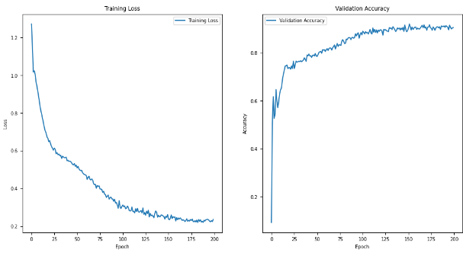
RESULT

Slide 17
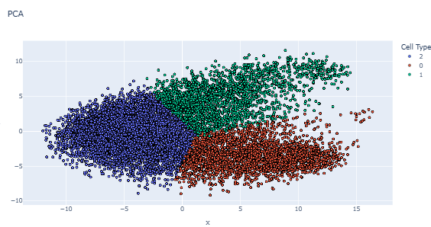
RESULT

Slide 18
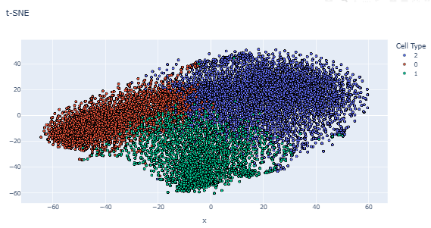
RESULT

Slide 19
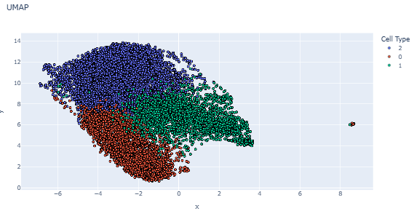
RESULT

Slide 20
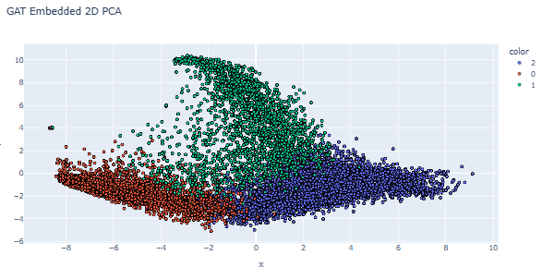
RESULT

Slide 21
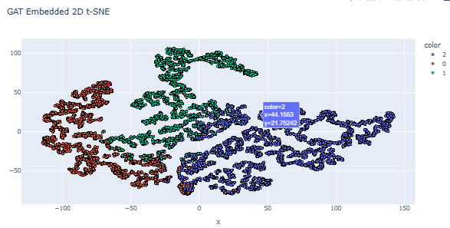
RESULT

Slide 22
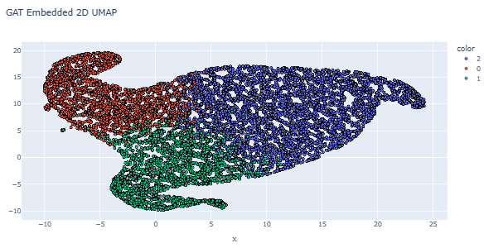
RESULT

Slide 23
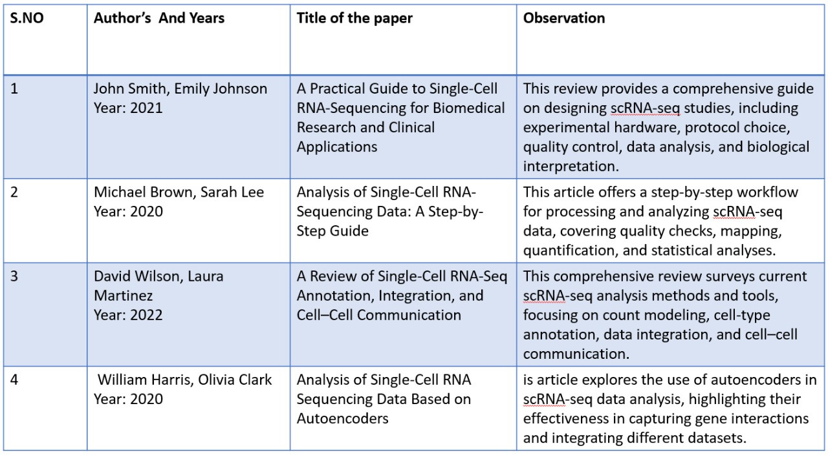
LITERATURE REVIEW

Slide 24
CONCLUSION
Using machine learning techniques for single-cell RNA sequencing (scRNA-seq) enables us to process and interpret complex cellular data with greater precision.
The use of techniques such as PCA, t-SNE, and UMAP helps visualize high-dimensional data, while clustering algorithms and models like GCN and GAT uncover distinct cell types and cellular relationships.

Slide 25
THANK YOU

